Slide 1
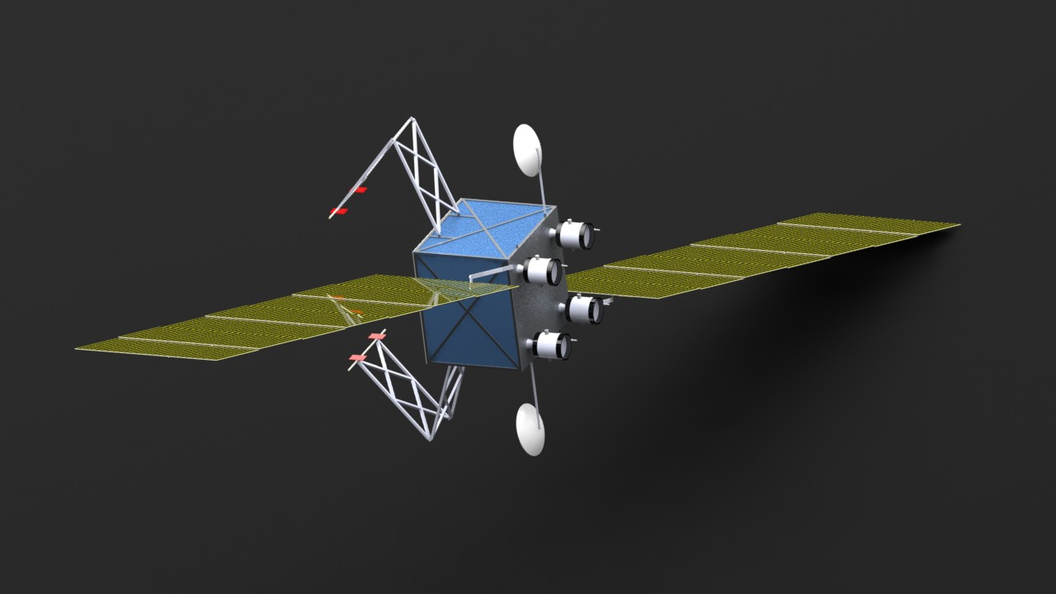
SpaceBots, Inc. presents
The FuelBot
A GEO Satellite Life-Extension Vehicle
s
Group #4
Gyu Hyeon Kim
Nathan Pandian
Cat Ticsay
Chung-Hau Wang
Mikey Zarem
May 8nd, 2013

Slide 2
Outline
Why is GEO Satellite Life-Extension Important?
Review of Previous Work
FuelBot Configuration and Layout
Trade Studies
Results and Cost
Conclusions and Recommendations

Slide 3
Why is GEO Satellite Life-Extension Important?
Geostationary orbit (GEO) satellites provide
  Cell phone communication
  Television broadcast
  Earth observation and surveillance
Fuel capacity limits GEO satellite life
  Station-keeping and graveyard orbit reposition require fuel
Satellite life extension could
  Increase operational life and return on investment
  Reduce GEO satellite buildup and orbital debris

Slide 4
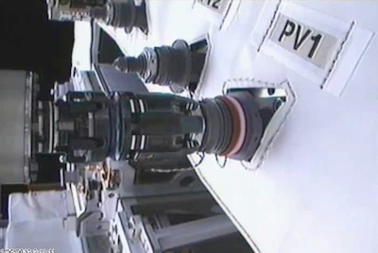
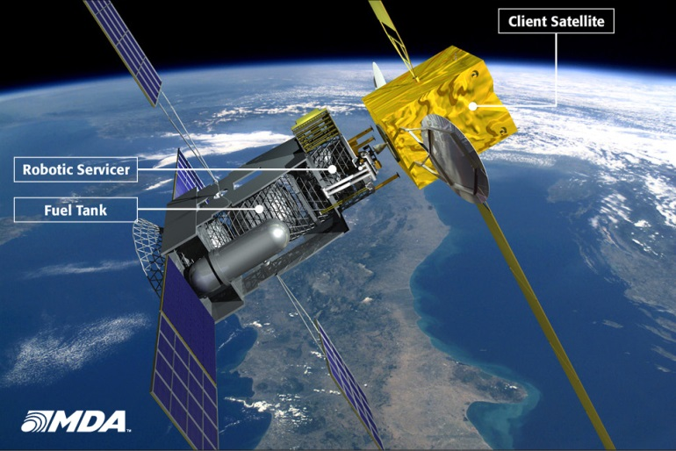
Previous Work in Satellite Life-Extension
NASA’s Robotic Refueling Mission
MDA’s Space Infrastructure Servicing
Vivisat’s Mission Extension Vehicle
There are currently no satellite operators signed up for a servicing mission, largely due to finances.
Image Credit: NASA
Image Credit: Macdonald, Dettwiler, and Associates

Slide 5
Design Requirements
Design a satellite to extend the life of existing and future geostationary satellites in a cost-effective method
Method
  Estimate the required propellant masses using orbital mechanics and spacecraft propulsion equations
  Size satellite subsystems based on resulting payload mass
  Determine expected cost for life extension satellite
Is it cost-effective to launch a life extension vehicle versus launching a new GEO satellite?

Slide 6
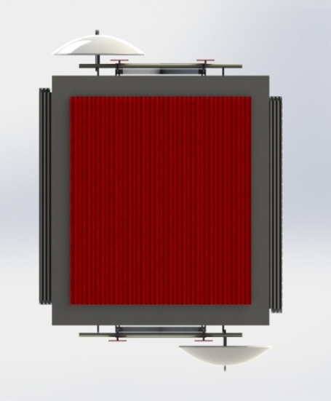
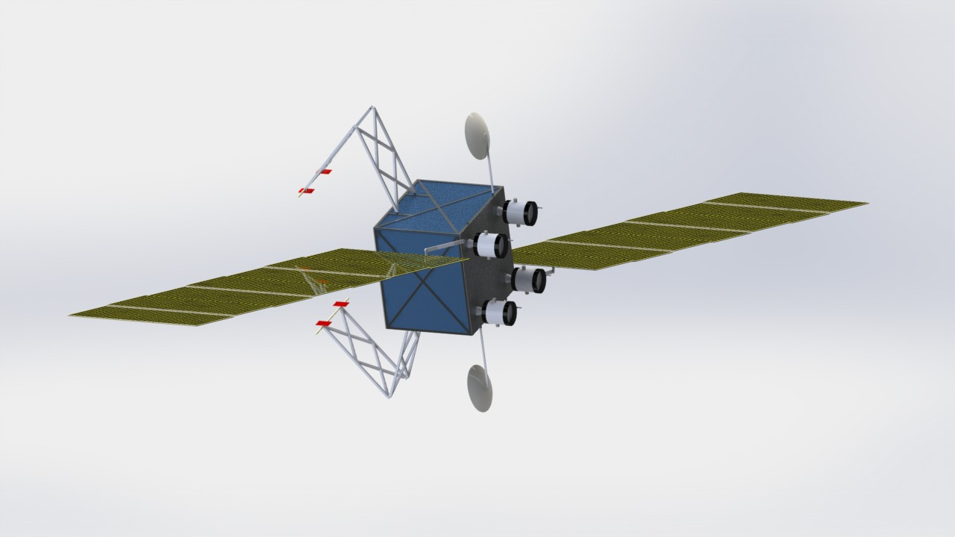
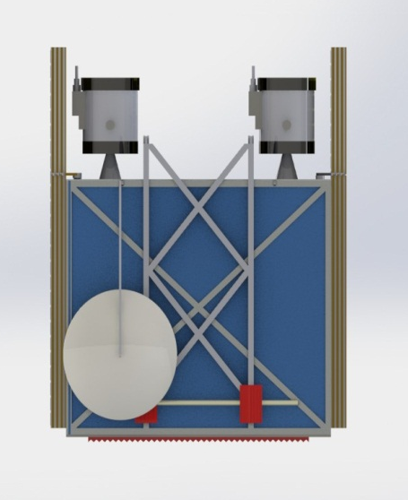
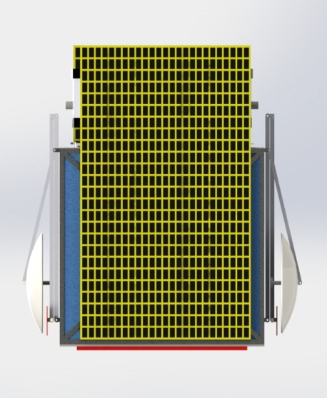
Our Solution – The FuelBot
1.6 m
1.4 m
1.5 m

Slide 7
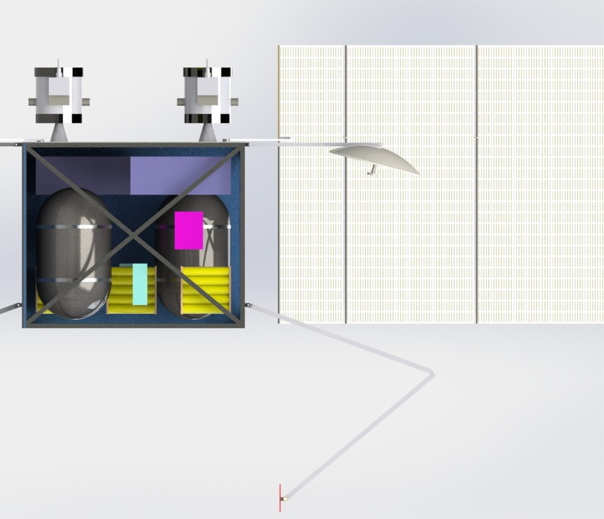
FuelBot Layout
Power Processing Unit
On-Board Processing
XIPS-25 Thruster
TT&C Box
Antenna
Solar Panels
Fuel Tank
Li-ion Batteries
Attachment Pads
Attachment Mechanism Frame

Slide 8
Life Extension Method
Method | Pros | Cons
Refueling | Potentially large number of refuels | No method for Xenon gas refueling exists
Satellite Piggyback | Precursor to any future Xenon refuel Orbit reposition capability | Life extension limited to a small number of satellites
Repair Satellite | Extend the life of satellites that are malfunctioning | High degree of complexity

Slide 9
LEO to GEO Orbital Maneuver
Electric or liquid propulsion?
Electric Propulsion
    Commonly used propellant = Xenon
    Used for constant thrust burns
Liquid Propulsion
    Commonly used propellant = MMH and NTO (hypergolic)
    Used for high-impulse burns
Propulsion System | Thrust | Time Needed for Transfer from LEO to GEO | Specific Impulse | Propellant Mass Percentage
Electric | Very Low | > 200 days | 1000 – 5000 s | 15 – 30%
Liquid | High | < 1 day | 100 – 400 s | 50 – 80%

Slide 10
Attachment Mechanism
Requirements
  Size range of satellites
  Acceptable location to grasp the client satellites
  Fuelbot orientation during attachment
Attachment Method | Pros | Cons
6 DOF Arm | Most versatile – Fuelbot can grab client satellites of various sizes | Highest level of complexity
3 DOF Arm | Maintains versatility while reducing the complexity of 6 DOF | Relatively complex method
Grab Back Panel of Client Satellite (No Arms) | Least complex method, with few moving parts | Not well-suited for small satellites Interference from apogee kick motor

Slide 11
Stationkeeping/Graveyard Orbit Insertion Propulsion
The Fuelbot must be able to
  Control the client satellite’s stationkeeping
    ΔV = 50 m/s for North/South stationkeeping
  Reposition the client satellite to a graveyard orbit at the end of the client’s functional life
The same ion thrusters used to travel from
LEO to GEO can serve these purposes.

Slide 12
Mission Profile
Total mission duration: 15 years
Number of clients per mission: 2
Launch to LEO
Low thrust transfer to GEO 1.9 years
GEO satellite piggyback #1 5.5 years
Low thrust transfer to graveyard orbit 7 days
Low thrust transfer to GEO 1 day
Drift to GEO satellite #2 3 months
GEO satellite piggyback #2 5.5 years
Low thrust transfer to graveyard orbit 7 days
    Fuelbot stays with the 2nd client at the end of its mission

Slide 13
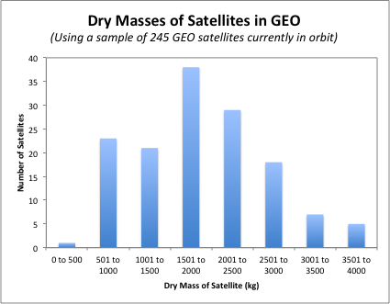
Mission Profile Flexibility
Most satellites fall between 500 – 3,000 kg in dry mass. The lighter client satellites provide more potential for life extension.

Slide 14
Propulsion System
Requirements
  Must minimize the FuelBot wet mass
  Must keep the mission lifetime to less than 15 years
Manufacturer | Name | Power (kW) | I_sp (s) | Thrust (mN)
L-3 | XIPS-25 low | 2.2 | 3,400 | 79
 | XIPS-25 high | 4.3 | 3,500 | 166
Aerojet/NASA | NEXT | 6.9 | 4,100 | 235
L-3/NASA | NSTAR low | 0.49 | 1,950 | 19
 | NSTAR medium | 1.48 | 3,180 | 58
 | NSTAR high | 2.31 | 3,280 | 92

Slide 15
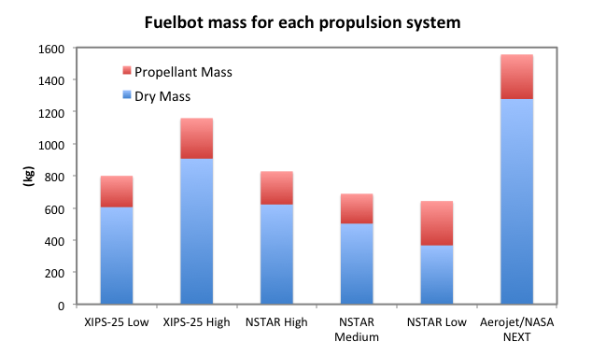
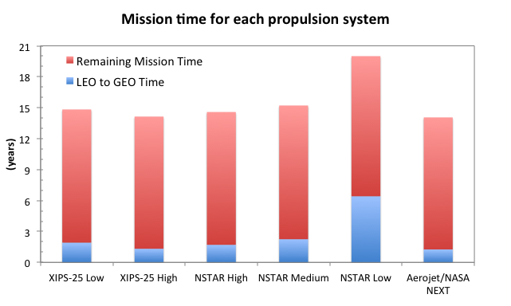
Propulsion System
The mission profile was iterated using each propulsion system to estimate the resulting wet mass and mission length.
The XIPS-25 low power system
  Has a low wet mass
  Meets the target mission time (14.8 years)
  Has significant flight experience on GEO communications satellites

Slide 16
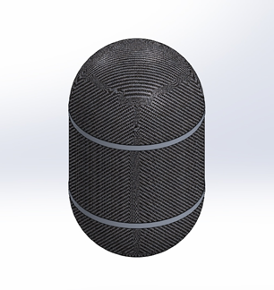
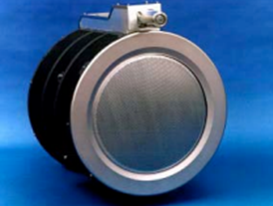

Propulsion System
The FuelBot propulsion system includes
  4 XIPS-25 low power thrusters (L-3)
  2 power processing units (L-3)
  2 cylindrical composite fuel tanks
    Total propellant capacity – 194.5 kg

Slide 17
Power System: Solar Panel
Accounting for degradation, solar arrays were sized
to produce 2.75 kW at the end of life.
Requirements
  Must provide an adequate supply of power for propulsion and other subsystems throughout its mission life
  Solar panel orientation must not block client satellite solar panels
Factors that affect solar panel sizing
  Annual losses, cell degradation due to temperature
  Angle of incidence
  Cell packing factor

Slide 18
Power System: Solar Panel
Final Solar Panel Performance and Characteristics
Parameter | Value
Power (BOL) | 4.44 kW
Array Area | 20.4 m²
Estimated Array Mass | 189.9 kg
Solar Cell Type | GaInP₂/GaAs/Ge Triple Junction
Efficiency (BOL) | 25.1%
Annual Losses, β | 2.75%/year
Charge Efficiency, h | 92%
Transmission (Discharge) Efficiency, H | 94%

Slide 19
Power System: Battery
Requirements
  The battery must provide an adequate supply of power for propulsion and other subsystems during eclipse seasons (72 minutes)
  To decrease the FuelBot dry mass, the battery’s specific energy should be large.
Battery | Specific Energy (W-hr/kg)
Nickel-Cadmium | 35
Nickel Metal Hydride | 42
Nickel Hydride | 40
Sodium Sulfur | 100
Lithium Ion | 150

Slide 20
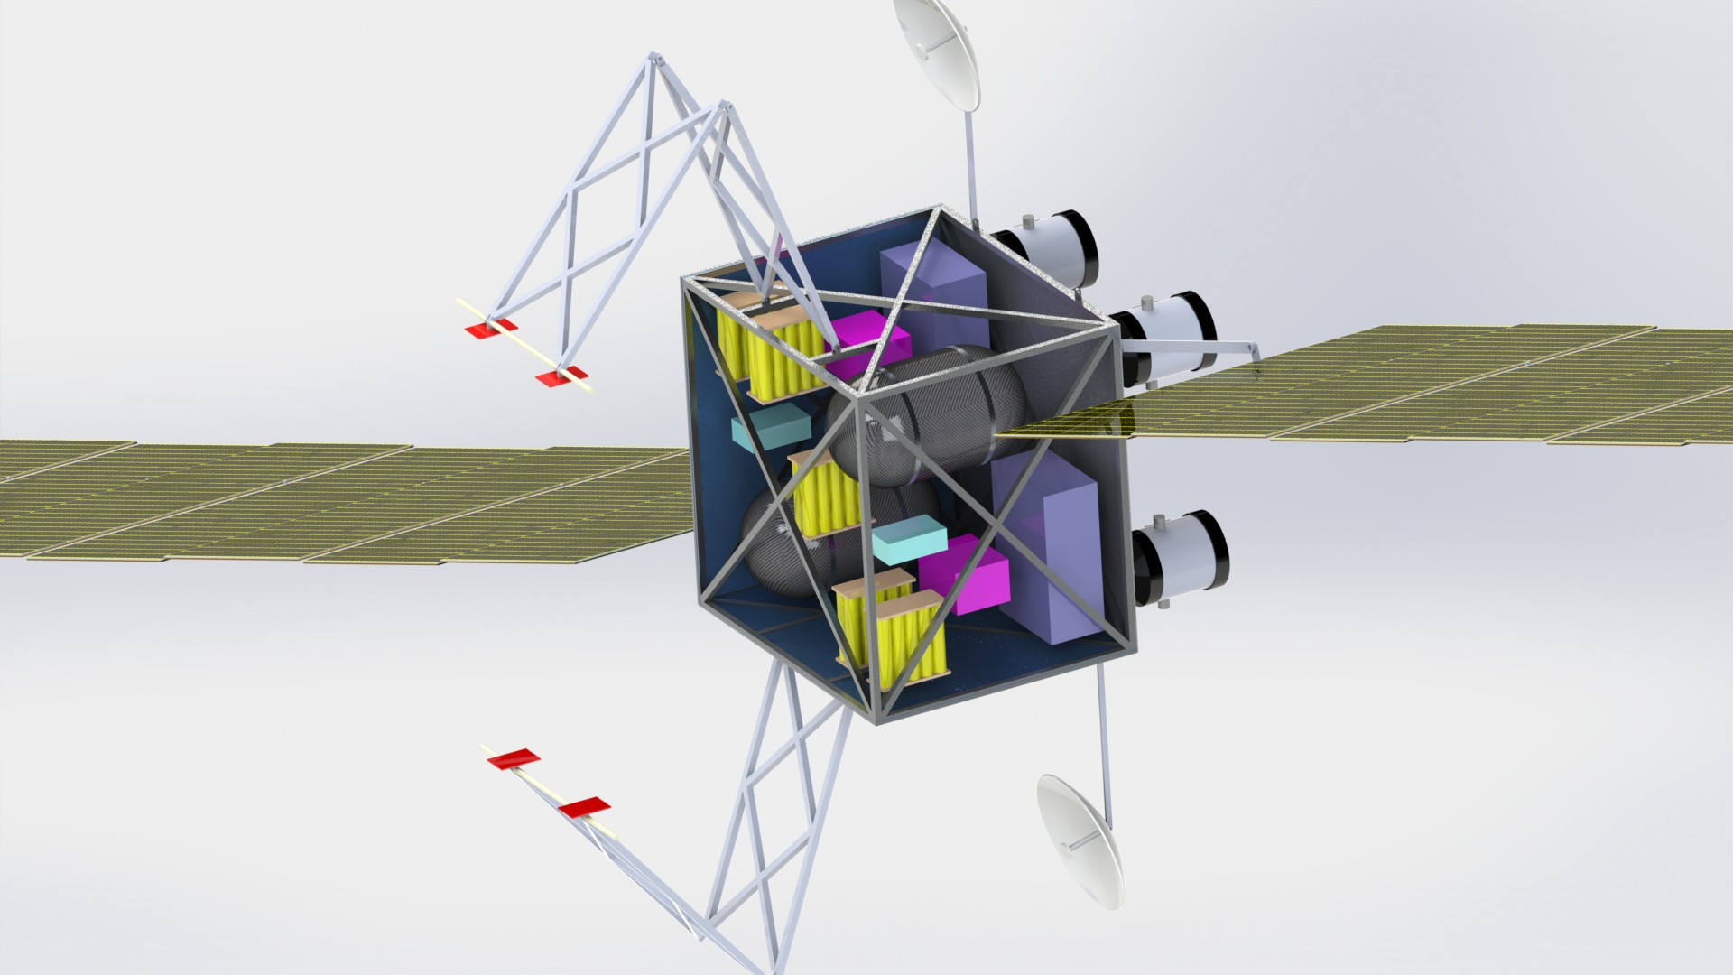
Structures and Mechanisms

Slide 21
Thermal Control
Component or subsystem | Operating T, °C | Survival T, °C
Batteries | 10 to 20 | 0 to 35
Analog electronics | 0 to 40 | -20 to 70
Digital Electronics | 0 to 50 | -20 to 70
Momentum Wheels Motors | 0 to 50 | -20 to 70
Solar Panels | -100 to 125 | -100 to 125
Propellant & Hydrazine | -45 to 65
Structures | -45 to 65
Solid-State Particle Detectors | -35 to 0 | -35 to 35
Infrared Detectors | -269 to -173 | -269 to 35
Working Environment Overview
Highly radiative
Freezing cold & crazy hot
Purpose of Thermal Control
  To maintain certain temperatures within room temperature, in which most active equipment can work normally

Slide 22
Thermal Control
System | Advantages | Disadvantages | Facilities in Fuelbot
PTC | More reliable Need less power Less expensive |  | Multi-Layer insulation Conduction paths Heat pipes Heat sensors
ATC | More suitable for temperature-sensitive equipment | Generally more complex Often heavier Consuming power May need telemetry resources
Notes:
MLI, which is a generally a 0.001-inch Kapton film backed with a few Angstroms thick layer of silver and being stuffed with multiple web-type layers of 0.00025-inch Kapton with a few Angstrom thick layer of silver on each side

Slide 23
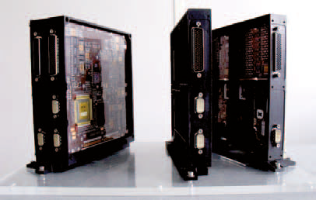
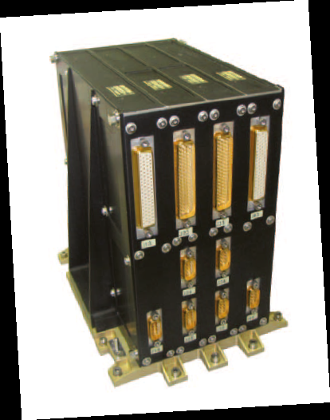
On-Board Processing
OSCAR--
  Compact, powerful and versatile On Board Computer based on LEON3 core
Picture courtesy: Astrium

Slide 24
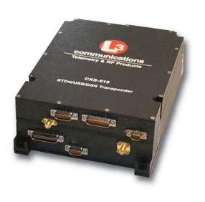
TT&C and Communications
Telemetry, Tracking, and Command (TT&C)
Universal TT&C model CXS-610
L-3 Telemetry-West
Specification of CXS-610
Receiver/Demodulator
Receive frequency | 2.025 ~ 2.120 GHz
Transmitter/Baseband
Transmit frequency | 2.200 ~ 2.300 GHz
Power Requirements
Input voltage | +28 VDC or +70 VDC
Max Power Transmitter (max) | 35 W
Max Power Receiver (max) | 5.5 W
Over/Reverse voltage | Provided
General
Dimensions (mm) | 1397 L x 2235 W x 782 H
Weight (max) | 2.63 kg
- Flight-proven; over 300,000-hours
- High-reliability; 15-year life
- NASA, ESA and commercial
- Communication function

Slide 25
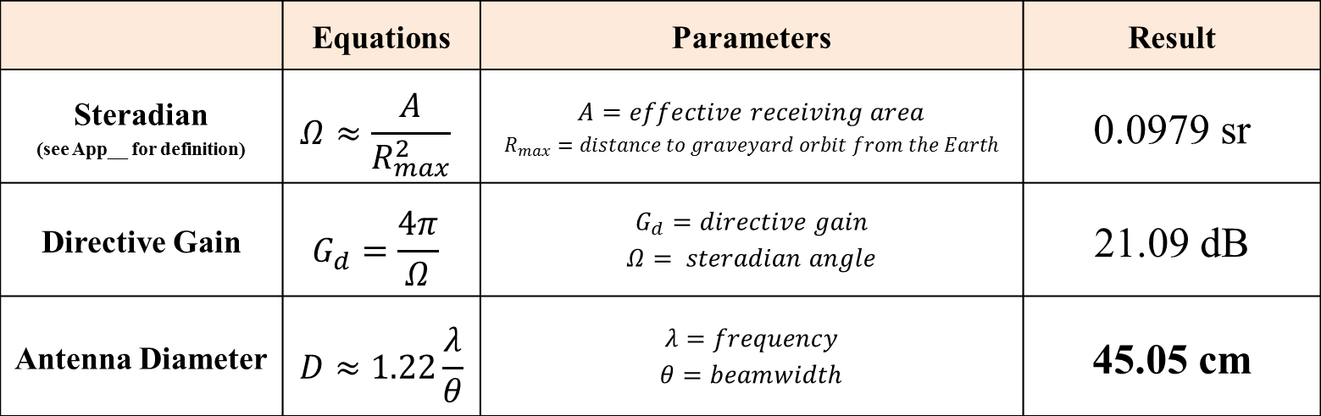
TT&C and Communications
Communication Antenna
Coverage : 6,378 km (Radius) ; half-sphere of the Earth
Radiation : 36,136 km (Distance) ; graveyard orbit
Frequency : 2.12 GHz / 2.30 GHz ; uplink / downlink
Type : dual parabolic antennas
 | Equations | Parameters | Result
Steradian (see App__ for definition) | $$Ω≈\frac{A}{R_{max}^{2}}$$ | $$A=effective receiving area$$ $$R_{max}=distance to graveyard orbit from the Earth$$ | 0.0979 sr
Directive Gain | $$G_{d}=\frac{4π}{Ω}$$ | $$G_{d}=directive gain$$ $$Ω= steradian angle$$ | 21.09 dB
Antenna Diameter | $$D≈1.22\frac{λ}{θ}$$ | $$λ=frequency$$ $$θ=beamwidth$$ | 45.05 cm

Slide 26
Mass Estimate
Subsystem | Sizing Mass (kg) | Component |  |  |  | Quantity | Mass per unit (kg) | Total Component Mass (kg) | Total Subsystem Mass (kg)
Structure and Mechanisms | 145.3 | Outer Aluminum Frame |  |  |  | 1 | 30 | 30 | 145.3
 |  | Attachment Mechanism Frames |  |  |  | 2 | 18 | 36
 |  | Attachment Pads |  |  |  | 4 | 5 | 20
 |  | Component Mounts and Fasteners |  |  |  | 1 | 25 | 25
 |  | Motors and Actuators |  |  |  | 1 | 34.3 | 34.3
Thermal Control | 24.2 | Multi-layer insulation (quantity given in m^2) |  |  |  | 1.44 | 3 | 4.32 | 24.32
 |  | Heat pipes (quantity given in m) |  |  |  | 2 | 9.5 | 19
 |  | Temperature sensors |  |  |  | 4 | 0.25 | 1
Power | 219.2 | Solar Panel |  |  |  | 14 | 13.57 | 189.98 | 245.48
 |  | Battery |  |  |  | 50 | 1.11 | 55.5
TT&C and Communication | 24.2 | Antenna |  |  |  | 2 | 9.5 | 19 | 24.26
 |  | L-3 CXS-610 Telemetry |  |  |  | 2 | 2.63 | 5.26
On-Board Processing | 18.2 | Flight computer |  |  |  | 1 | 5.2 | 5.2 | 18.2
 |  | Thermal control processor |  |  |  | 2 | 2 | 4
 |  | Power management |  |  |  | 2 | 4.5 | 9
 |  |  |  |  |  |  |  | 0
Attitude Determination, Control | 36.3 | Gyroscope |  |  |  | 2 | 12 | 24 | 36
 |  | Horizon Sensor |  |  |  | 2 | 3 | 6
 |  | Proximity Sensor |  |  |  | 2 | 1 | 2
 |  | Sun Sensor |  |  |  | 2 | 2 | 4
 |  |  |  |  |  |  |  | 0
Propulsion | 119.6 | XIPS-25 Thruster |  |  |  | 4 | 13.7 | 54.8 | 119.55
 |  | Connections |  |  |  | 3 | 2.85 | 8.55
 |  | XIPS-25 Power Processing Unit |  |  |  | 2 | 21.3 | 42.6
 |  | Composite Fuel Tank |  |  |  | 2 | 6.8 | 13.6
Other | 18.2 | Launch vehicle attachment components |  |  |  | 1 | 18.2 | 18.2 | 18.2

Slide 27
Mass Estimate
Subsystem | Mass (kg)
Structure and Mechanisms | 145.3
Thermal Control | 24.32
Power | 245.48
TT&C and Communication | 24.26
On-Board Processing | 18.2
Attitude, Determination, and Control | 36
Propulsion | 119.55
Other | 18.2
Total Dry Mass | 631.31
System | Mass (kg)
FuelBot Dry Mass | 631.31
Xenon Propellant | 194.5
FuelBot Wet Mass | 825.81

Slide 28
Cost Analysis
Methods
  Non-recurring(NR)/Recurring(T1) Cost by USCM 9
  Cost Improvement by 0.95 Learning Rate
  Cash Flow of GEO satellite operation w/ the FuelBot
Results
  $ 60.29 M (NR) / $ 36.25 M (T1)
  $ 36.25 M (T1) was reduced to $ 29.04 M (20 FuelBots)
  Customer will earn $3.42 M
    If FuelBot extends 5 years of life on15th year
→ GREAT IMPACT on the future GEO satellite market

Slide 29
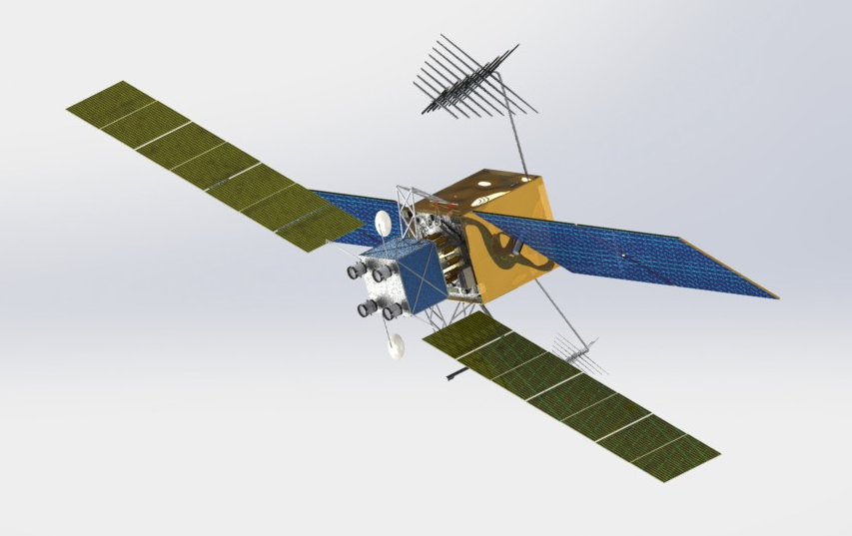
Conclusions
FuelBot is a real option
  Technology
  Price/Market
Conservative design = mission variety

Slide 30
Recommendations
Greater cooperation can revolutionize GEO
Satellite manufacture industry participation:
  Universal xenon fuel transfer
  Design changes for rendezvous
  Improved inter-satellite comms
  Improved high-earth sat tracking = denser GEO

Slide 31
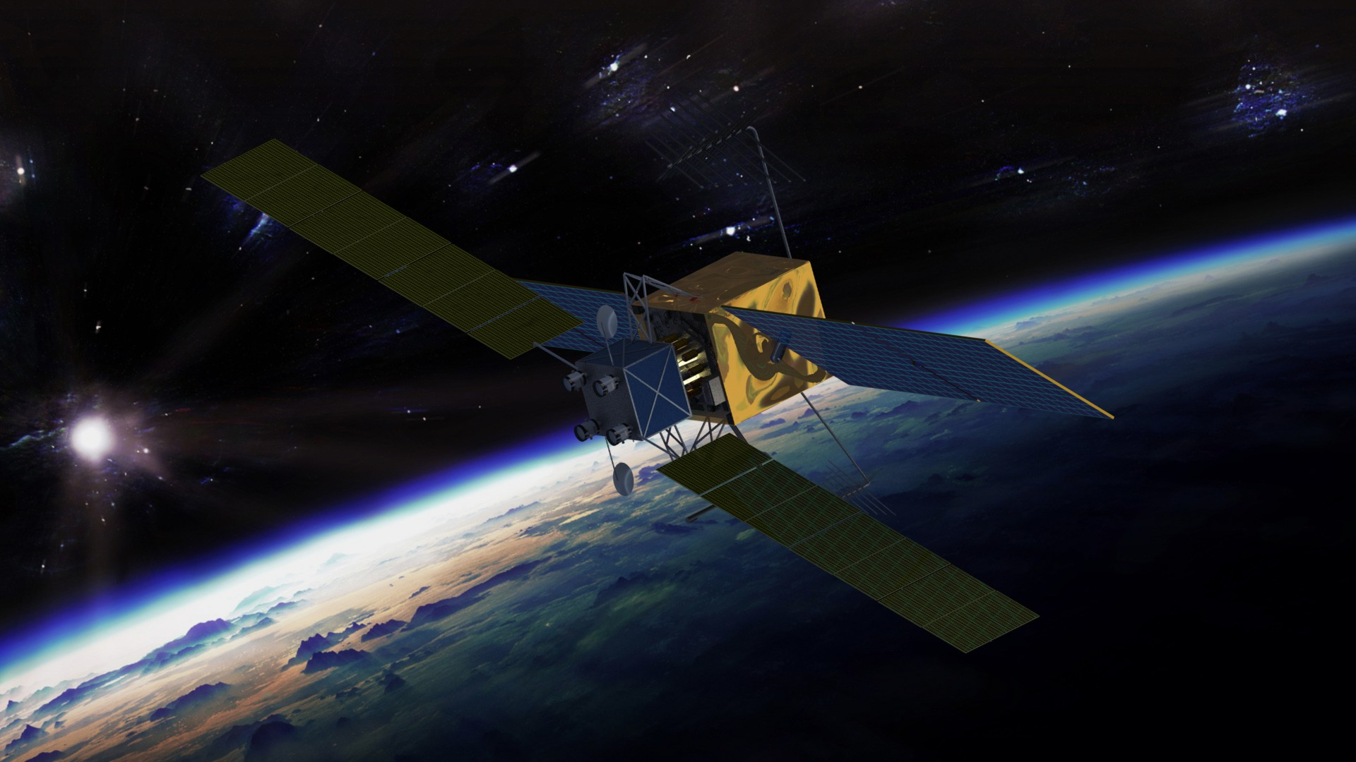
Questions?

Slide 32
Appendix – Fuel Tank Sizing
Goal: minimize tankage fraction
  (Total Fuel Tank Mass) / (Propellant Mass)
Assumptions
  Storage pressure - 8.3 MPa
  Xenon density - 1.35 g/ml, Xenon propellant mass – 194.5 kg
Shape | Spherical Tank |  | Cylindrical Tank with Spherical Endcaps
Material | Ti-6Al-4V | Composite | TI-6Al-4V | Composite
Tankage Fraction (%) | 9.27 | 2.46 | 11.30 | 3.00
Tank Mass (kg) | 9.00 | 4.39 | 11.00 | 6.90

Slide 33
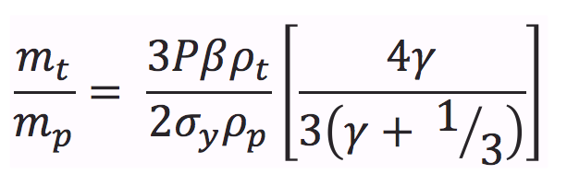
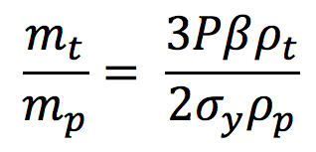
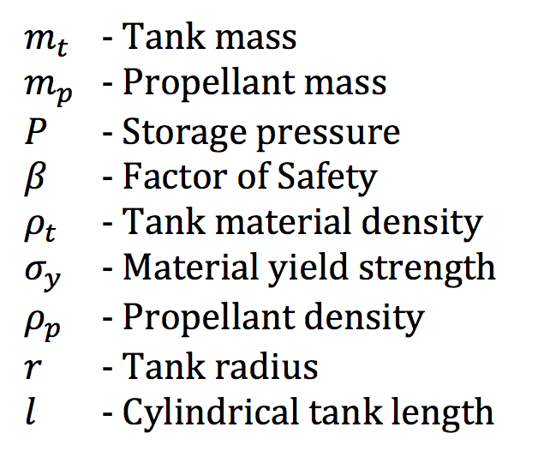
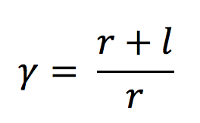
Appendix – Fuel Tank Sizing
Spherical Tank
Cylindrical Tank
Source: Richard Welle, “Propellant Storage Considerations for Electric Propulsion”, The Aerospace Corporation

Slide 34
Appendix – Cost Estimation (NR)
Non-recurring(NR) – USCM 9 CERs
Non-recurring CER Category | Input Mass [kg] | CER Equation (for lbs.) | Output Cost ($1,000)
Structures and Mechanisms | 145.29 | Y = 23.437 * X | $7,507
Thermal Control | 24.22 | Y = 118.030 * X ^ 0.455 * 3.116 | $2,247
Electrical Power | 219.19 | Y = 24.652 * X ^ 0.803 * 2.394 | $8,440
Attitude Control | 36.32 | Y = 127.420 * X ^ 0.653 * 5.456 | $12,165
Propulsion - Thrusters | 106.00 | Y = 48.018 * X | $11,221
Propulsion – Fuel Tanks | 13.83 | Y = 43.006 * X ^ 0.685 | $447
TT&C | 24.22 | Y = 177.8 * X ^ 0.6938 * 3.458 | $9,711
Communication Antenna | 18.16 | Y = 506.438 * X ^ 0.766 | $8,551
TOTAL |  |  | $60,290

Slide 35
Appendix – Cost Estimation (T1)
Recurring(T1) – USCM 9 CERs
Non-recurring CER Category | Input Mass [kg] | CER Equation (for lbs.) | Output Cost ($1,000)
Structures and Mechanisms | 145.29 | Y = 6.603 * X | $7,507
Thermal Control | 24.22 | Y = 1180.582 | $1,181
Electrical Power | 219.19 | Y = 43.88 * X ^ 0.7955 * 1.383 | $8,286
Attitude Control | 36.32 | Y = 87.583 * X ^ 0.782 * 1.701 | $4,589
Propulsion - Thrusters | 106.00 | Y = 48.018 * X | $11,221
Propulsion – Fuel Tanks | 13.83 | Y = 43.006 * X ^ 0.685 | $447
TT&C | 24.22 | Y = 62.049 * X ^ 0.915 * 1.591 | $1,823
Communication Antenna | 18.16 | Y = 31.524 * X ^ 0.986 | $1,199
TOTAL |  |  | $36,252

Slide 36
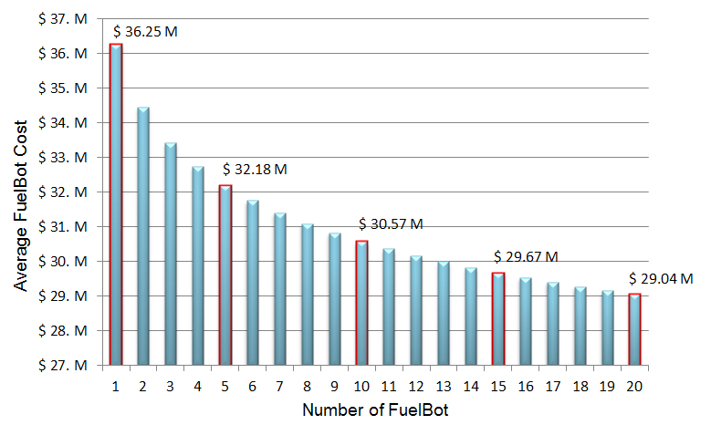
Appendix – Cost Improvement
Cost Improvement on 0.95 learning curve slope

